Slide 1

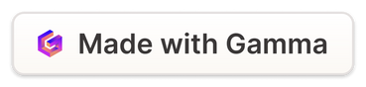
Plant Care Database - Demo Presentation
Many plant owners struggle with keeping up with their plant's care schedule, leading to an unhealthy plant due to overwatering, underwatering, or incorrect maintenance.
by Tiana Maea
Notes:
1

Slide 2
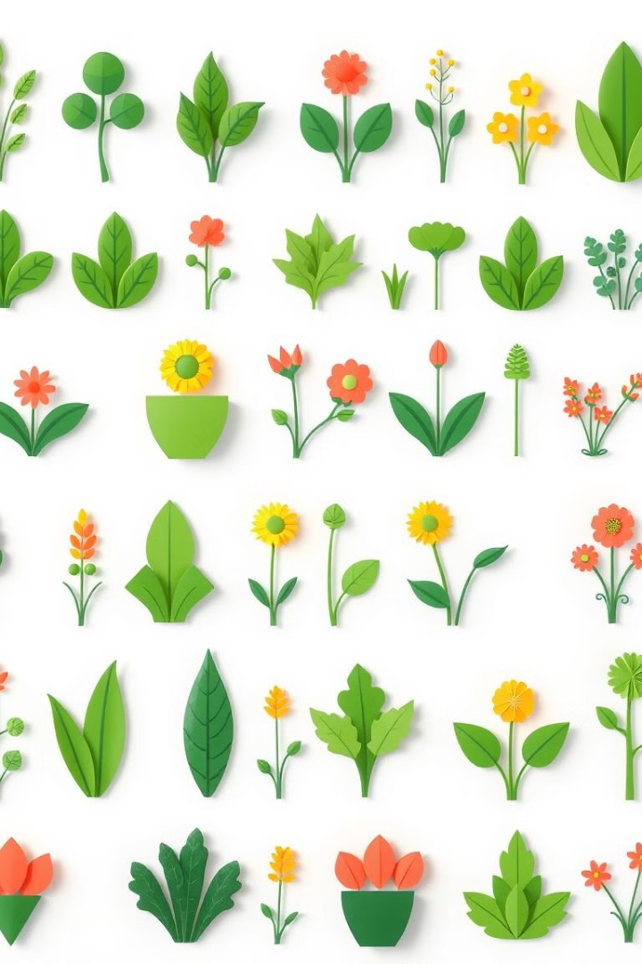




Key Features
Add & Manage Plants
Set Care Reminders
Access Plant Care Guides
Get notifications for watering, fertilization, and pruning schedules. Never miss a crucial care task.
Easily add plants to a personal library with detailed care information. Keep track of each plant's unique needs.
Search for and browse a database of plant care tips. Expert advice is always at your fingertips.
Data Stored Securely
All plant data is saved in an organized database for easy retrieval. Your plant information is safe and accessible.
Notes:
2

Slide 3
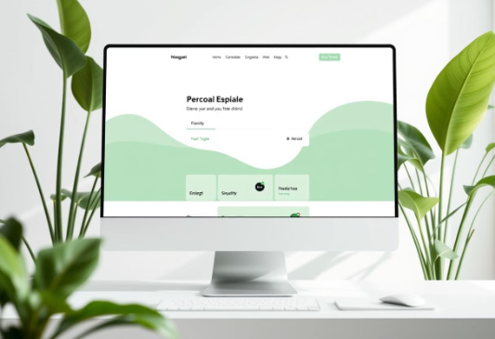
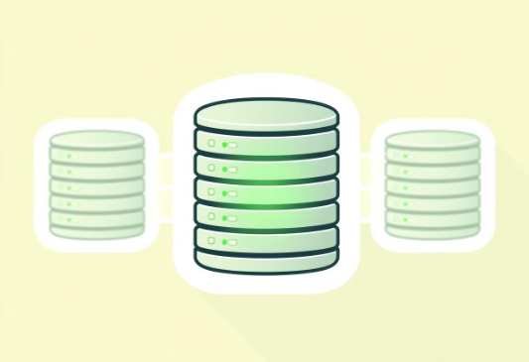

System Architecture Overview
Frontend
Database
Backend
The user interacts with the web application, providing an intuitive and engaging experience for managing plant care.
Stores plant information, care logs, and user reminders. Secure and organized data storage ensures data integrity and fast retrieval.
Processes data, manages user requests, and handles reminder notifications. Ensures seamless operation and efficient data handling.
The workflow is simple: User adds a plant → Plant details stored in the database; User sets reminders → Notifications are scheduled; User searches care guides → Relevant information is retrieved and displayed.
Notes:
3

Slide 4






Demo Roadmap/Future Enhancements
Step 1: Advanced Search Filters
Users will have the ability to customize their searches using an advanced filter setting in the search bar. This will allow for more precise results
based on plant type, care requirements, and other criteria.
Step 2: Plant Profile
Open a pre-filled plant profile, examine the detailed information stored for each plant.
Step 3: Edit Plant Information
Edit plant information & save changes, modify care schedules to match plant's requirements.
Step 4: Set Up Reminders
Set up a watering or fertilization reminder, receive timely notifications for plant care.
Step 5: Browse Care Guide
Browse the plant care guide & retrieve useful tips, access expert advice for plant maintenance.
Step 6: Data Storage
Brief explanation of how the system stores data, understand the backend structure and data management.
Notes:
4

Slide 5

Conclusion & Next Steps
1
Recap
A quick recap of demonstrated features, highlighting core functionalities.
2
Efficiency
How the system helps users track and care for plants efficiently, optimizing plant health.
3
Enhancements
Upcoming enhancements before the final version, potential AI and Community features.
4
Feedback
Encouraging feedback and Q&A session, improving the application.
Notes:
5

Slide 6

How does this product benefit you
Efficient time management
Less plant loss
With the smart reminder system, you will have a lower chance of harming your plants through neglect
This product reduces the time you spend on planning and executing plant care tasks
More efficient knowledge
With expert advice right at your fingertips, growing plants has never been easier
Notes:
6

Slide 7
Thank You! Questions?
Notes:
7

